Slide 1
COMS 4111: Introduction to Databases Lecture 17: Midterm, Data Address Space, Buffer Mgmt., Indexes, Transactions (I)
Dr. Donald F. Ferguson
dff9@columbia.edu

Slide 2
Comments Observations

Slide 3
Indexes

Slide 4
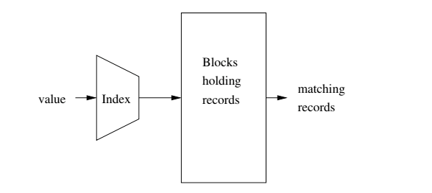
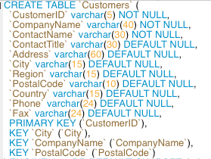
Index
Block will map to
In memory block in frame or
Address in Data Address Space.
Column values or set of column values.
Garcia-Molina et al.
Indexes are created on
Simple keys = e.g. a single column.
Composite keys = a set of columns, e.g. (last_name, first_name)
Most common index implementations are: Hash, B+ Tree
An entry in an index if of the form – (k, v):
k is the key value.
v is one of: 1) the data itself (tuple), 2) the address in data address space of tuple, 3) a list of addresses
Index can be unique/non-unique, dense/sparse, clustered/unclustered, ordered/hashed.

Slide 5
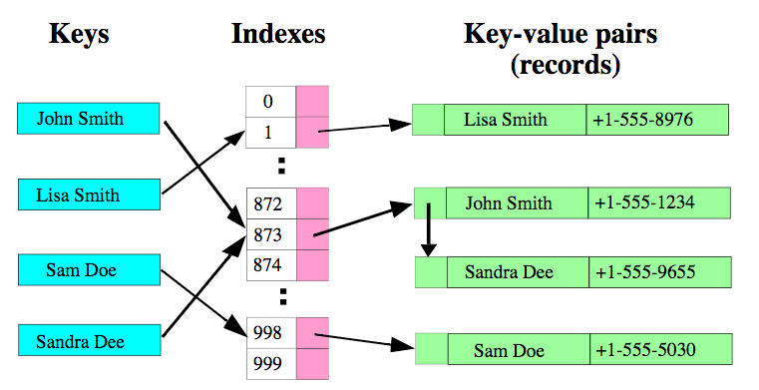
Hash Index – Basic Data Structure

Slide 6
Database Hash Index
Index blocks are disk blocks, just like data blocks.
The format is
Key value
Data value
The data value may be
The actual record, or
The logical address for the data block and record ID holding the tuple.
Block 0
Block 1
H(x) = x MOD 5
Block 2
Key = X
Block 3
Block 4
Block 2 -- Overflow

Slide 7
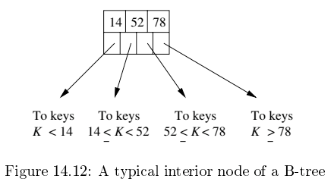
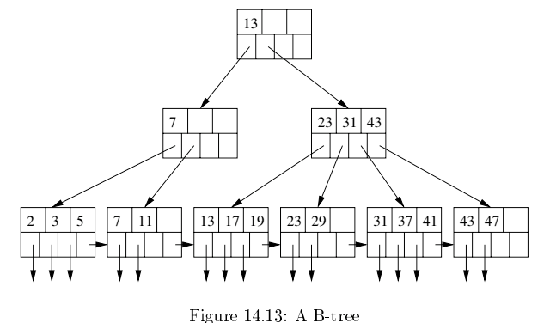
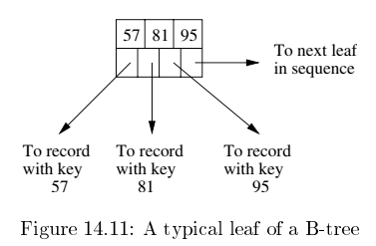
B+ Tree
Based on concept of a binary search tree, but with two core modifications
Unit of transfer to/from memory is a block, which will hold many (key,record) maps.
Accessing records in order (WRT to index) is common → clustering is common.
The node format is always (m keys, m+1 pointers)

Slide 8
Some Comparisons
B-Tree supports
WHERE operators =, >, >=, <, <=, BETWEEN and LIKE (for operands).
MIN(), MAX()
ORDER BY
WHERE clauses with partial keys and AND. A key on (c1, c2, c2) is actually a set of indexes of the form (c1), (c1,c2) and (c1,c2,c3).
Estimates of the number of records in a range (for query optimization).
Hash Index
Extremely fast for the (key, value) data model.
Only for operators =, NOT =
Does not support partial keys.

Slide 9
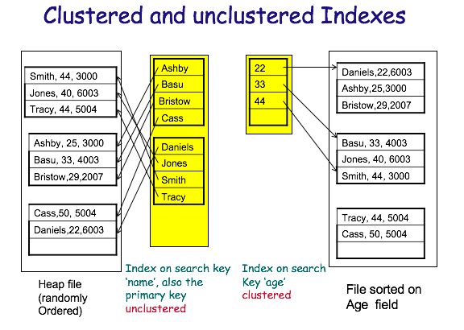
Clustered vs Unclustered
Order of keys in index is approximately the same as order of records in file.

Slide 10
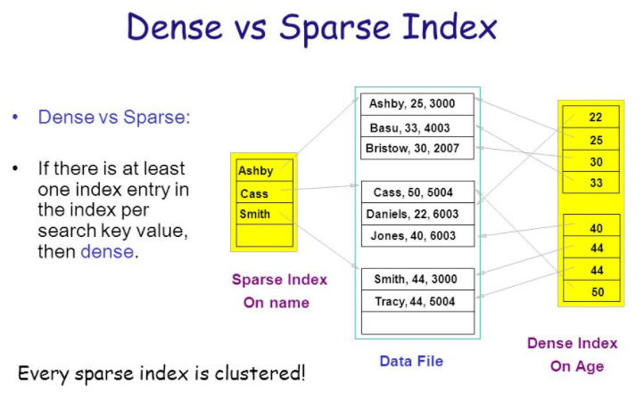
Dense versus Sparse Index
“Storage and File Structure. Architecture of a DBMS,” Shona Holmes.
http://slideplayer.com/slide/6841281/

Slide 11
Summary
We have just skimmed the surface of indexing
There are several variations and extensions to Hash and B-Tree indices.
Various data structure/algorithm aspects related to
Adding/deleting entries
Merging/splitting nodes
etc.
Conditions/guidance for choosing between options.
Other kinds of indices
FULLTEXT
Bitmap
Compressed (Key)

Slide 12
Query Processing and Optimization

Slide 13
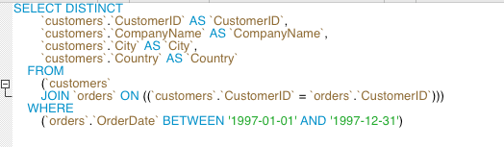
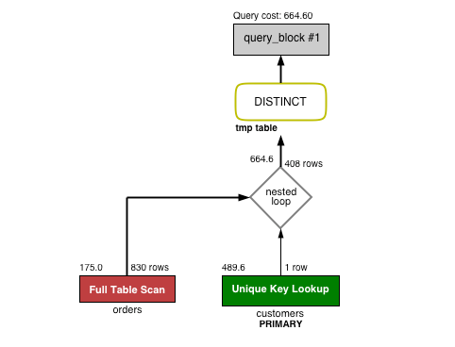
Concept

Slide 14
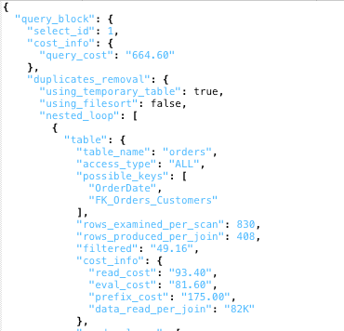
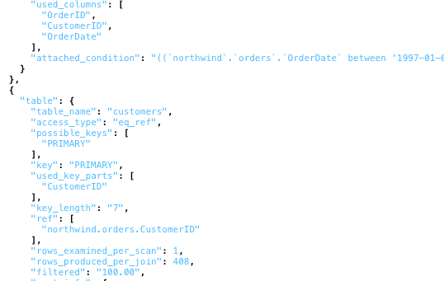
Execution/Plan

Slide 15
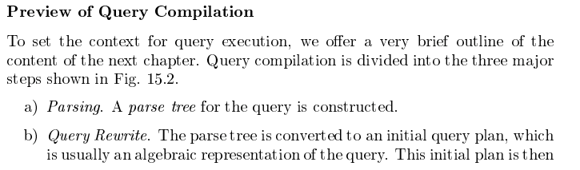
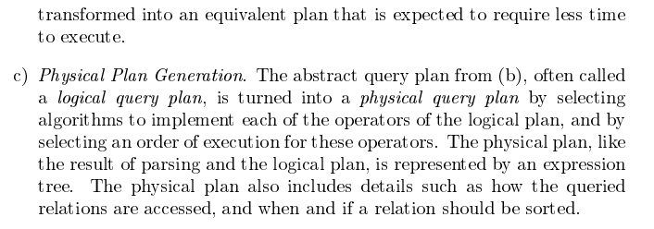
Query Compilation/Execution

Slide 16
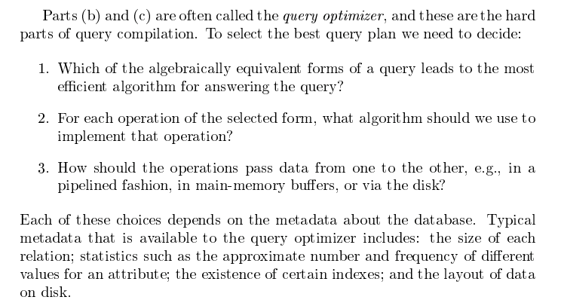
Continued

Slide 17
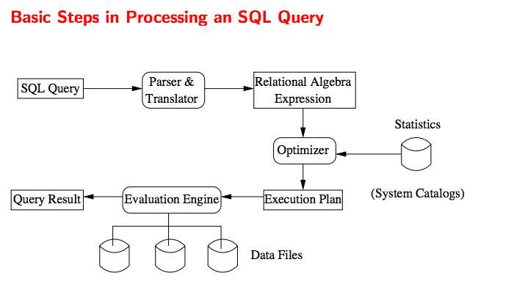
Basic Steps

Slide 18
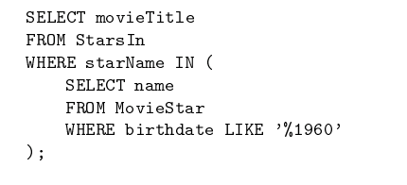
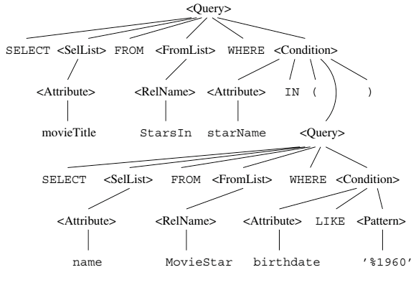
Parsing and Compilation
SQL is a language
DDL is like class, variable declarations.
DML is like expressions.
PL-SQL is control flow.
Just like all languages
Parsing produces
A parse/evaluation tree.
That is then compiled or interpreted.
Garcia-Molina et al., p 763

Slide 19
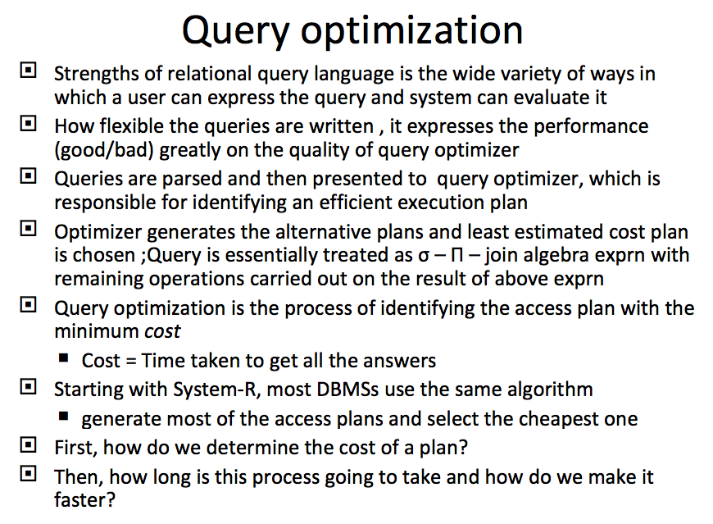
Overview of Query Evaluation (https://www.slideshare.net/avniS/overview-of-query-evaluation)

Slide 20
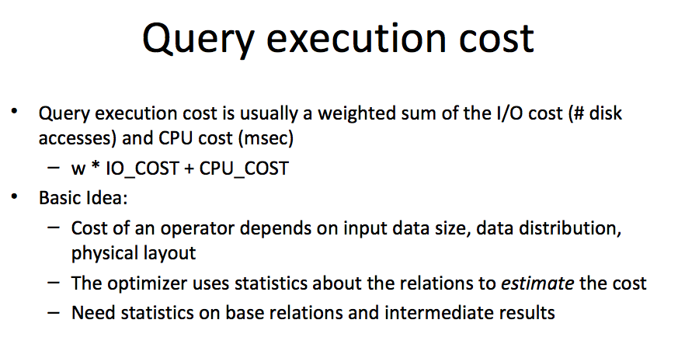
Query Cost

Slide 21
Access Path
Every relational operator accepts one or more tables as input. There are two “ways” to retrieve the tuples
Scan the relation (via blocks)
Use an index and matching condition.
A selection condition is in conjuctive normal form if
Each term is column_name op value
op is one of <, <=, =, >, >=, <>
The engine can select a matching index
A Hash Index on (c1,c2,c3) if the condition is c1=x AND c2=y AND c3=z.
A Tree Index if the condition is (can be ordered as)
c1 op value
c1 op x AND/OR c2 op y
… …
Many indexes may match, and the engine chooses the most selective match (number of tuples or blocks) that match.

Slide 22
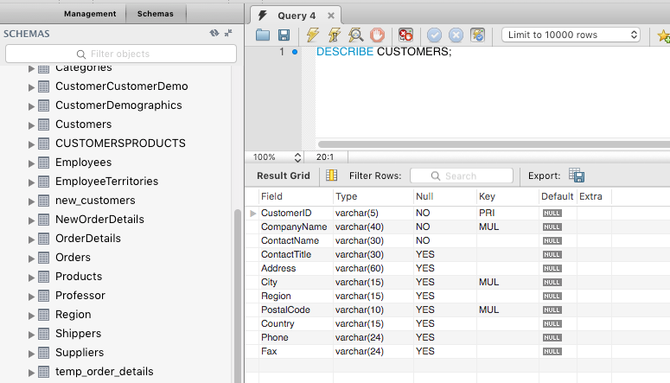
The Catalog

Slide 23
The Catalog Contains
For each table
Table name, storage information.
Attribute name and type for each column.
Index name, type and indexed attributes
Constraints
Statistical information
Cardinality of each table
Size: No. of blocks.
Index cardinality: Number of distinct key values for each index
Index size: Number of blocks for each index.
Index tree height
Index ranges

Slide 24
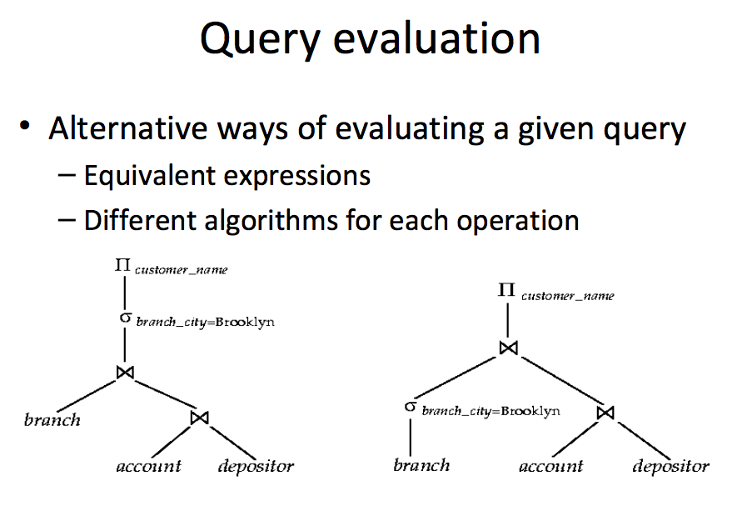
Many Ways to Evaluate a Query

Slide 25
Simple Technique – SELECTion Pushing
Consider two relations
StarsIn(title, year, star_name)
Movies(title, year, length, genre, studio_name, producer_no)
Find everyone who starred in a comedy movie in 1996
Query 1:
SELECT star_name, FROM StarsIn JOIN Movies ON StarsIn.title=Movies.title AND StarsIn.year=Movies.year WHERE StarsIn.year=1996 and Movies.genre=‘Comedy’
Query 2:
SELECT star_name FROM (SELECT star_name, title, year FROM StarsIn WHERE year=1996 as a) JOIN
(SELECT title, year, genre FROM Movies WHERE year=1996 AND genre=‘Comedy’) ON a.year=b.year and a.title=b.title
These queries are equivalent, but (2) is much more efficient.

Slide 26
Simple Technique – SELECTion Pushing
SELECT on a JOIN of table R and table S compares O(#(R)*#(S)) tuples
Have to load relevant blocks
Compare the tuples to compute the JOIN
Scan the JOIN to apply the SELECT
Pushing the SELECT(s) through the JOINs
May vastly reduce the size of the table to JOIN
Only JOIN tuples that could be selected in the WHERE clause.
You can also push project through JOIN, but this reduces the size of the data, not the number of tuples examined.
Consider two relations
StarsIn(title, year, star_name)
Movies(title, year, length, genre, studio_name, producer_no)
Find everyone who starred in a comedy movie in 1996
Query 1:
SELECT star_name, FROM StarsIn JOIN Movies ON StarsIn.title=Movies.title AND StarsIn.year=Movies.year WHERE StarsIn.year=1996 and Movies.genre=‘Comedy’
Query 2:
SELECT star_name FROM (SELECT star_name, title, year FROM StarsIn WHERE year=1996 as a) JOIN
(SELECT title, year, genre FROM Movies WHERE year=1996 AND genre=‘Comedy’) ON a.year=b.year and a.title=b.title
These queries are equivalent, but (2) is much more efficient.

Slide 27
This is just a quick, random overview.
We will spend one more lecture on this topic.
Bus again, this is a huge area with a tremendous about of work and innovation.

Slide 28
A Digression

Slide 29
What is happening?
A Data Definition Statement Defines or “Creates” a definition/type of data, which is needed for DML.
“Client” App 1
Connection
DDL Statement
“Client” App 2
Database
Management
System
(Instance)
“Client” App …
DML Statement
A Data Manipulation Statement Creates, Retrieves, Updates or Deletes Data.

Slide 30
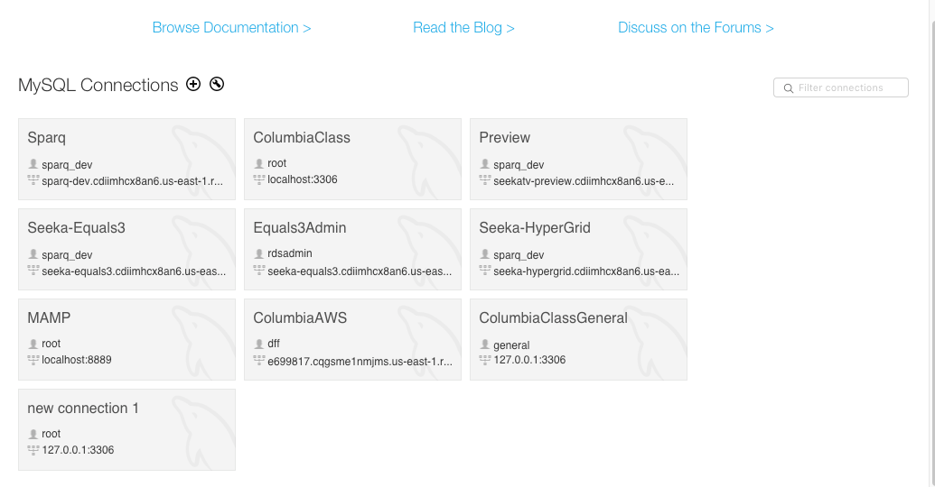
Multiple Databases

Slide 31
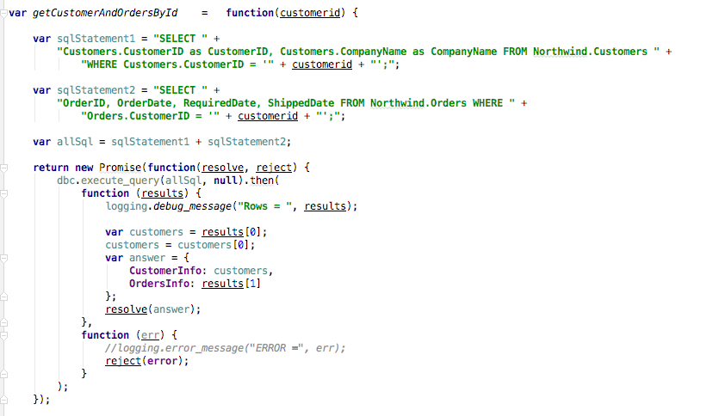
Some Code

Slide 32
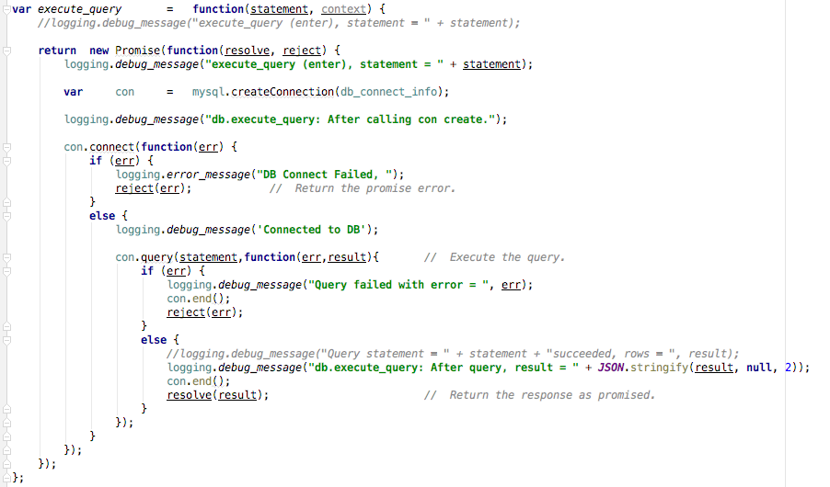
Sample Application

